Slide 1
Combinational Logic
Logic gates.
and, or, not
Derived gates.
nand, nor, xor
John F. Wakerly – Digital Design. 4th edition. Chapter 4.

Slide 2
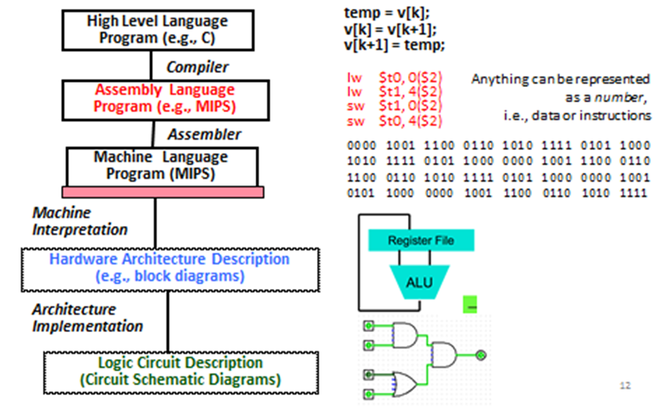
Logic design

Slide 3
Logic gates
Electronic circuits which combine digital signals according to the Boolean algebra are referred to as logic gates
Gates - because they control the flow of information.
&
There is no limit to the number of inputs that may be applied to a function,
so there is no functional limit to the number of inputs a gate may have.
However, for practical reasons, commercial gates are most commonly manufactured with limited inputs (2, 3, or 4 ).
In digital circuits all inputs must be connected.

Slide 4
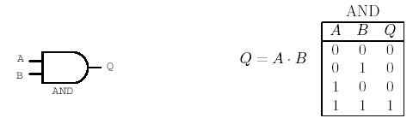
The AND gate
&
The AND gate implements the AND function.
With the gate shown to the left, both inputs must have logic 1 signals applied to them in order for the output to be a logic 1.

Slide 5
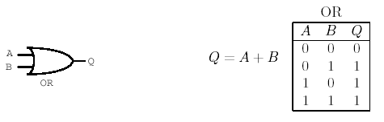
The OR gate
1
The OR function, like its verbal counterpart, allows the output to be true (logic 1) if any one or more of its inputs are true.

Slide 6
How the gates work ?
Besides implementing of the logical AND, OR functions the above mentioned devices have also “gate” functions.
With each of these devices the “gate” function works differently
There is a status of the gate - OPEN or CLOSE.
When the gate is OPEN then the logical value of the input (signal) can pass to the output of the gate.
When the gate is Closed then the logical value of the input (signal) can not pass to the output of the gate.
A
A
Z
B
B
B
Closed
Opened

Slide 7
Control and data input. AND
To force the device to work as a gate we have to satisfy the input conditions.
For the AND gate the logical value 1 of one of the inputs of the gate allows the other input’s value to pass to the output.
The output of the AND gate will be always 0 if one of the inputs we keep = 0.
The input which we intentionally keep in 0 or 1 condition we call the control input.
The other input which is passed or not to the output we call the data input.
Conrol Input
Conrol Input
Conrol Input
1
1
0
&
0
&
1
&
0
0
1
B
Data Input
Data Input
Data Input
Opened
Opened
Closed

Slide 8
OR gate
For the OR gate the control input should be 0 to allow the data input to pass to the output (Opened).
If we keep the control input =1 then the OR gate will be closed keeping the output value stable 1.
Conrol Input
Conrol Input
Conrol Input
0
0
1
1
0
1
1
1
1
0
1
B
Data Input
Data Input
Data Input
Opened
Opened
Closed

Slide 9
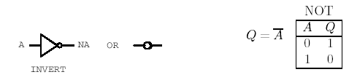
Inverter
The inverter has exactly one input as well as one output.
Whatever logical state is applied to the input, the opposite state will appear at the output.
The circle at the output of the NOT gate denotes the logical inversion

Slide 10
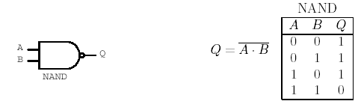
Derived Logical Functions and Gates
The three basic functions AND, OR, and NOT are sufficient to accomplish all possible logical functions and operations
Some combinations are used so commonly that they have been given names and logic symbols of their own: NAND, NOR, XOR.
The circle at the output of the NAND gate denotes the logical inversion, just as it did at the output of the inverter.
The NAND Gate
&

Slide 11
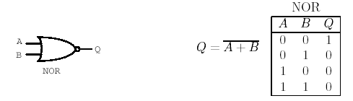
The NOR Gate
The NOR gate is an OR gate with the output inverted.
1

Slide 12
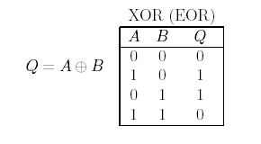

The Exclusive-OR, or XOR Gate
The XOR gate produces a logic 1 output only if its two inputs are different.
If the inputs are the same, the output is a logic 0
It’s comparator
A
A
⊕
1
⊕
0
different
equal
B
B

Slide 13
Combinational and sequential logic circuits.
Logic circuits are classified into two types, “combinational” and “sequential.”
A combinational logic circuit is one whose outputs depend only on its current inputs.
Sequential circuits are designed to actually remember the past states of their inputs, and to produce outputs based on those past signals as well as the current states of their inputs.
These circuits can act in accordance with a sequence of input signals, and are therefore known as sequential logic circuits.
combinational logic circuits – don’t have memory, are very fast
sequential logic circuits - have memory, are slow

Slide 14
Typical Hardware Design Flow

